Slide 1
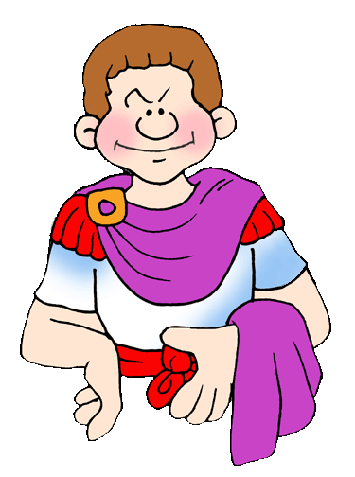
Nero at the Circus Maximus
Ancient Rome
Shared by Lin Donn
Illustrated by Phillip Martin

Slide 2

Nero
The Roman Empire lasted for 500 years.
In the 500 years Rome was an empire, Rome had over 140 different emperors! Emperors had absolute rule. They controlled the government, the military, and the people.
One of the most famous Roman emperors was Nero.

Slide 3
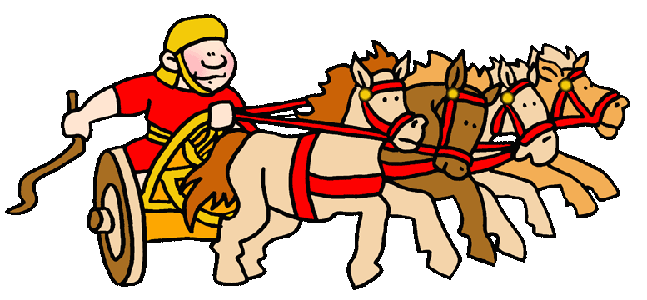
Circus Maximus
At first, the people thought Nero was rather fun. He was always doing crazy things. One day, Nero showed up at the Circus Maximus, ready to race!

Slide 4
Circus Maximus
The Circus Maximus was a huge outdoor arena, with seating for 250,000 people. It was used mostly for chariot racing by the best professional racers.

Slide 5
Circus Maximus
There were other circuses around the empire, but the Maximus was the most famous. There were races every day. Admission was FREE!

Slide 6
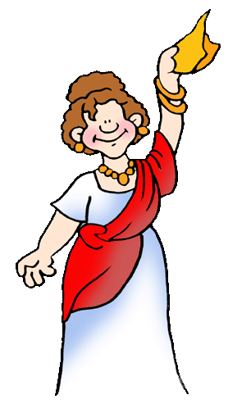
Circus Maximus
At the circus, people cheered loudly for their favorite team. There were usually four teams. Their colors were red, blue, green, and white.
If you were cheering for the red team, you would wave and wear something red.

Slide 7
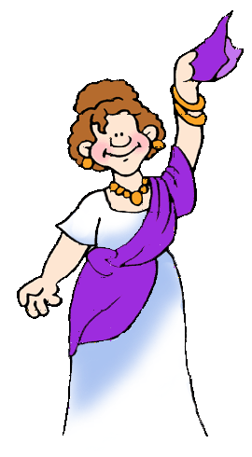
Circus Maximus
Nero’s color was purple.
At first, people cheered loudly for Nero. He tried very hard to win.
Unfortunately, Nero had little skill as a racer. In fact, he was just plain terrible!

Slide 8
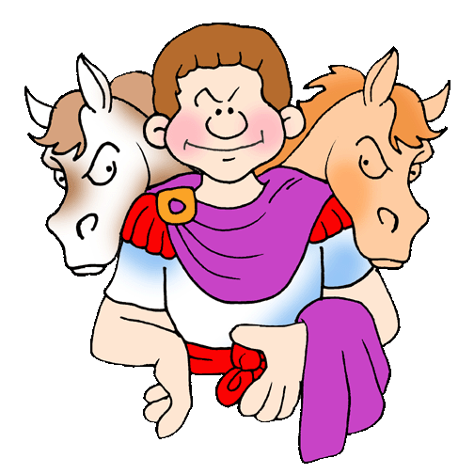
Nero
Since
horses
were not
working
very well ..

Slide 9
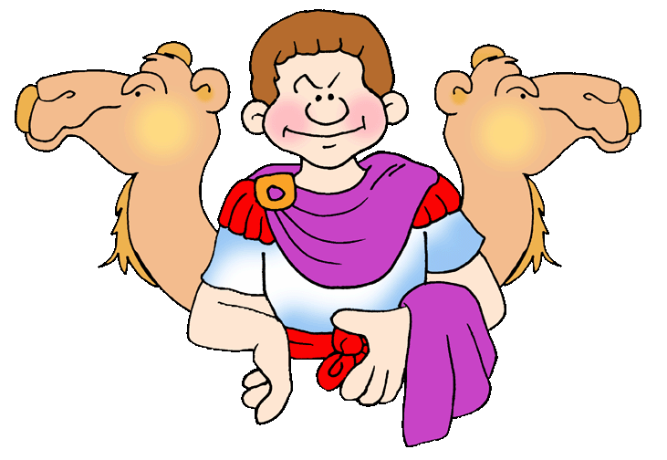
Nero
Nero
tried
hitching
camels
to his
chariot.
Camels
can move very rapidly.
Unfortunately, it takes skill to race them well.

Slide 10
Nero
Next, he tried holding races at night, when no one could see what was going on.
He declared himself the winner of every race, even when he wasn’t racing. But for some reason, few people attended the night races.

Slide 11
Nero
So Nero cheated.
Each chariot was supposed to be pulled by four horses.
Nero hitched 10 horses to his chariot to give himself a huge advantage over the other racers.

Slide 12
Nero
He still would have lost every race. He was that bad. Only no one dared to beat him.
Anyone who tried had a fatal “accident” soon after.

Slide 13
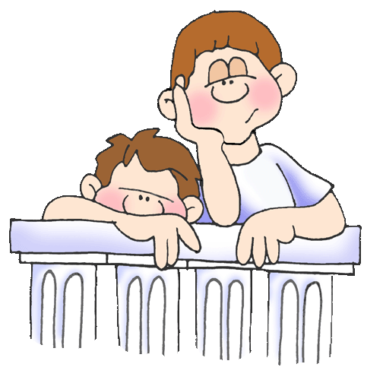
Nero
Since Nero always won, the 250,000 fans who came to cheer their favorite racer found the Circus Maximus rather dull if Nero was there.

Slide 14
Question
Why were people bored when Nero raced at the Circus Maximus?

Slide 15
Answer
Nero always declared himself the winner.

Slide 16

To Learn More
Go here:
Ancient Rome for Kids

Slide 17
Free Clip Art &
Templates
Created by a professional and published artist, Phillip Martin, go here to find:
Free Clip Art for Ancient Rome
Free Templates for presentations in PowerPoint format & how to use them!

Slide 18
Presentations
Free Presentations in PowerPoint format written by us
To see some of the neat things we’ve written and illustrated, go here: We’re Published!

Slide 19
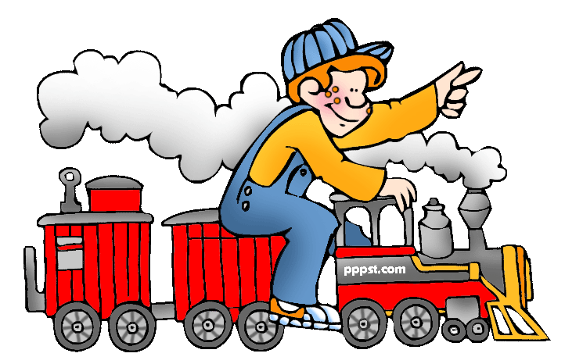
Explore …
PPPST.COM

